Slide 1
Working with Payments
April 11, 2024

Slide 2
Agenda
Paying Online
Set Up
Adding Fees
Invoices
Payment Plans
Discounts
Transaction Reports

Slide 3
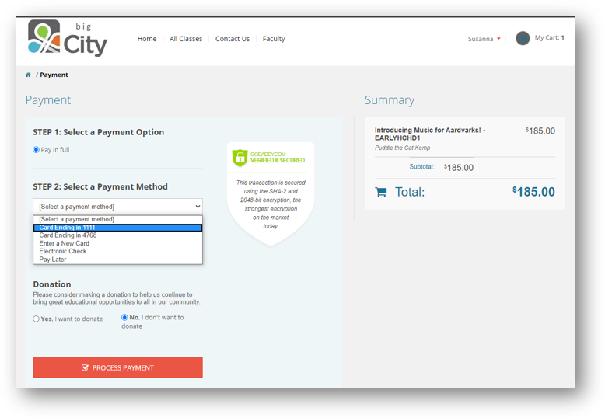
How your customers pay online...

Slide 4
Set Up

Slide 5
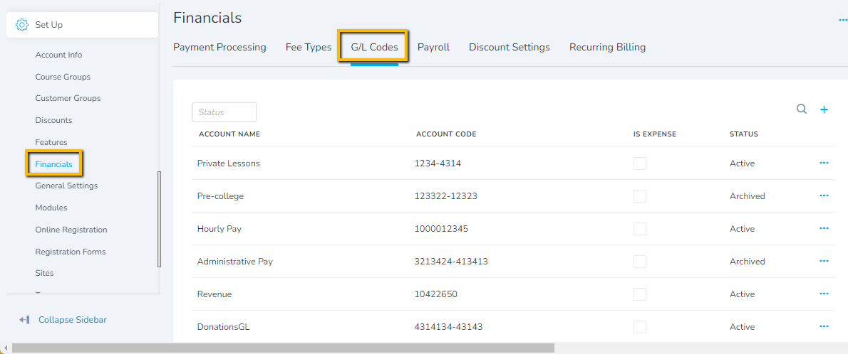
Set Up General Ledger Codes (GL)
Set Up - Financials

Slide 6
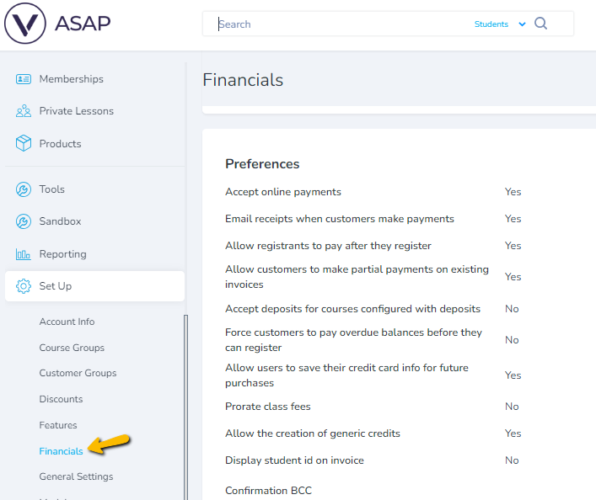
Set Up Preferences
Set Up - Financials

Slide 7
Adding Fees

Slide 8
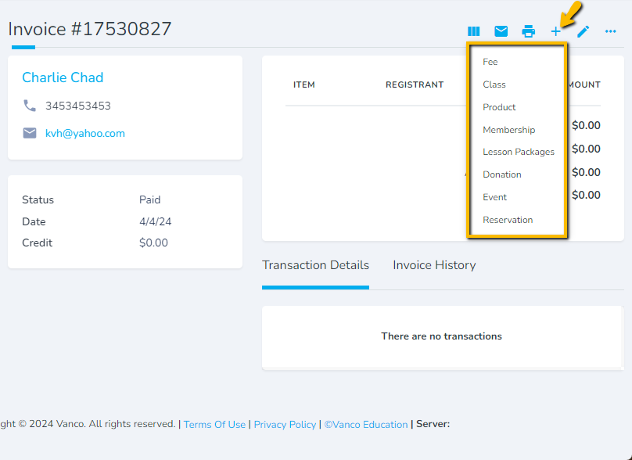
Adding Fees

Slide 9
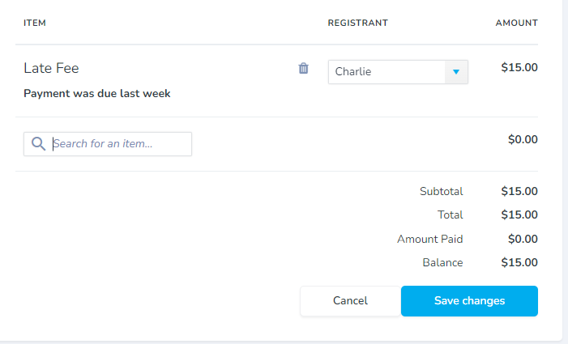
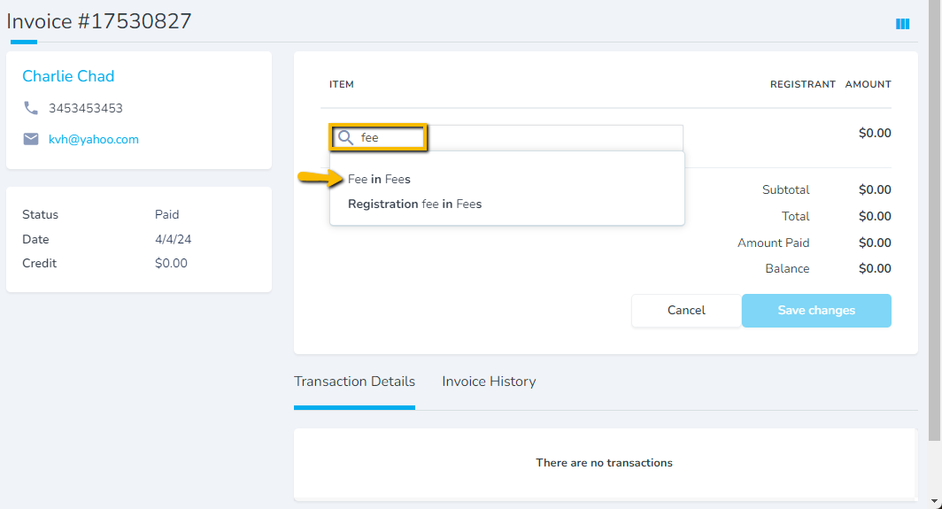
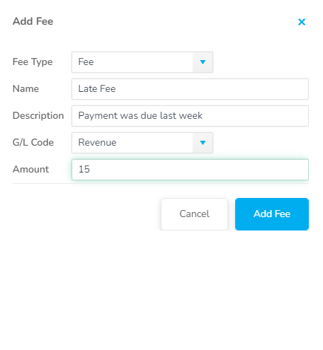
Adding Manual Fees

Slide 10
Invoices

Slide 11
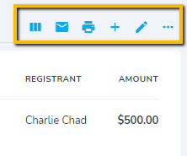
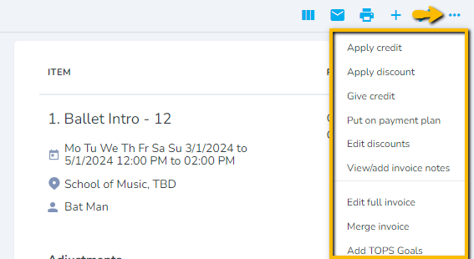
Invoices
Invoice View – Full, Medium, Summary
Email invoice to customer
Print invoice
Add items
(classes, products, etc)
Edit invoice
(edit/remove payment plans, delete incorrect payments)
Manage credits, refunds, payment plans, payment reallocations, discount reallocations
Invoice Management

Slide 12
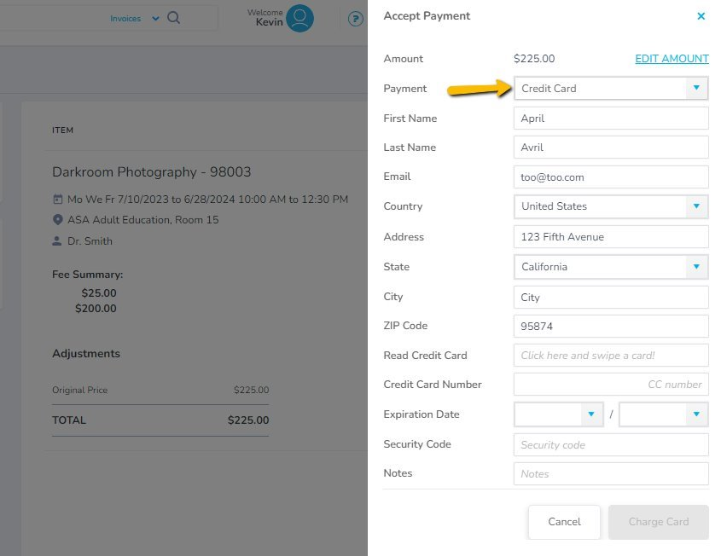
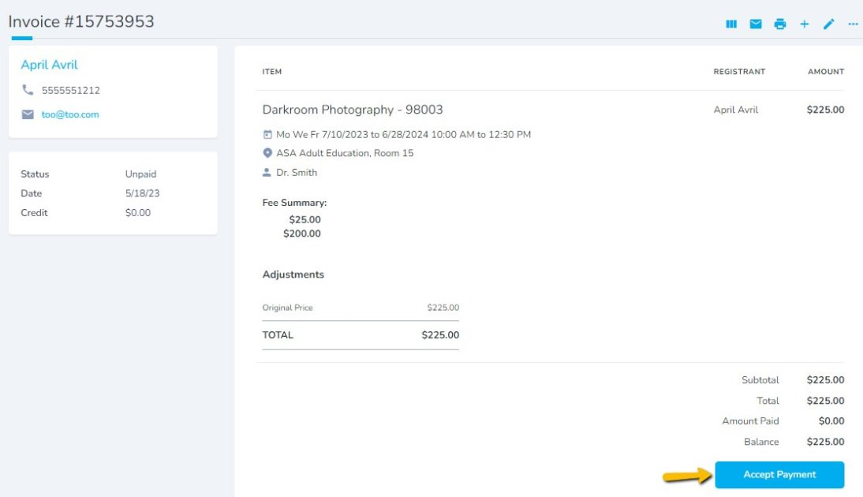
Accepting Payments
Invoice Management

Slide 13
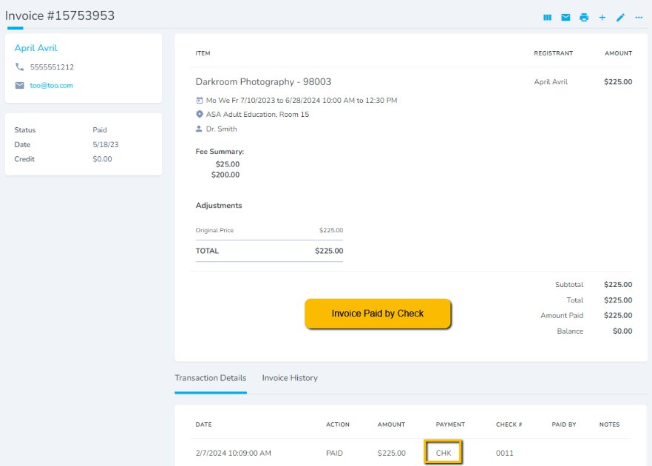
Accepting Payments
Invoice Management

Slide 14
Payment Plans

Slide 15
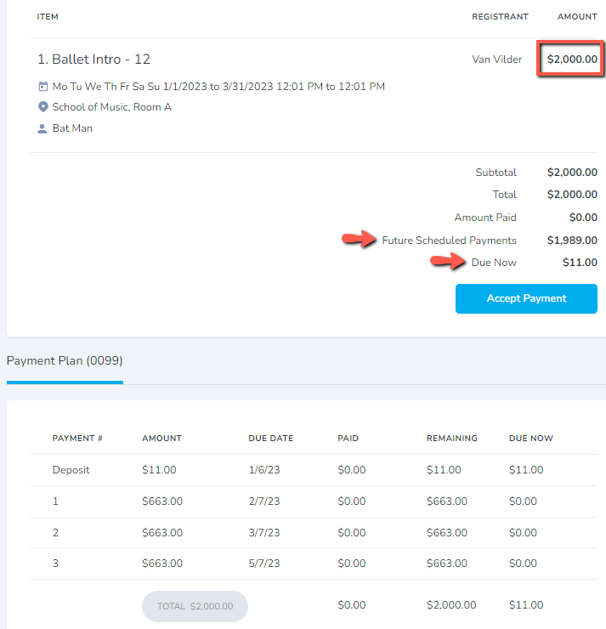
Payment Plans
Scenarios
Automatically charge Credit Cards or ACH when payment is due
Allow a registrant to pay a $2,000 balance in installments
Your school offers classes that are paid month-to-month
Payment Plans

Slide 16
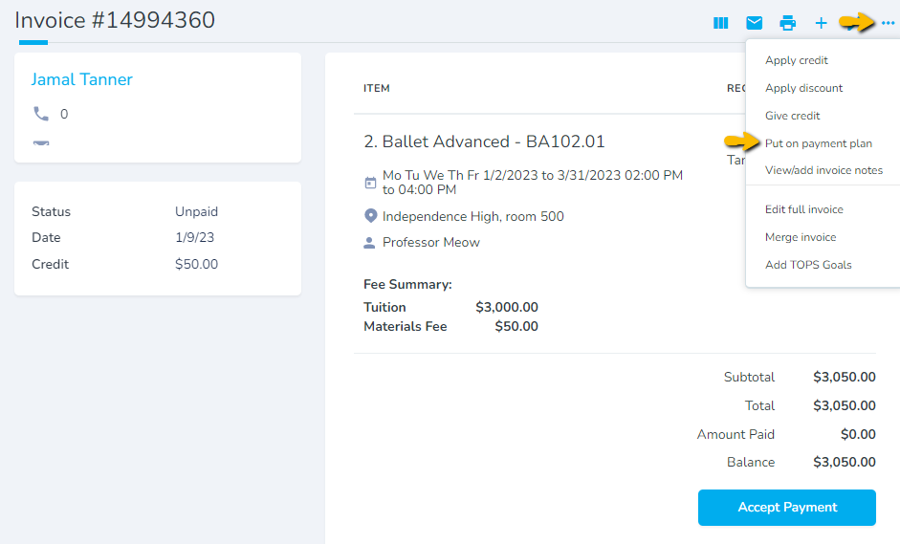
Payment Plans
Putting an Invoice on a Payment Plan through the Admin Portal.
Payment Plans

Slide 17
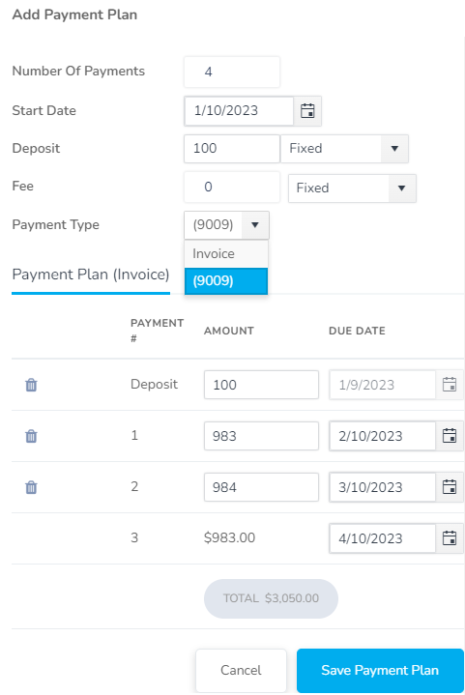
Payment Plans
Auto Charge Credit Card
To auto charge Credit Cards or ACH when payment is due, there MUST be a Credit Card or ACH saved on file. Select CC or ACH on file under "Payment Type" drop down.
Email an Invoice
If no CC or ACH selected, customer will be emailed an invoice with PayNow button.
Payment Plans

Slide 18
Discounts

Slide 19
Creating Discounts
What kind of discount would you like to create?
Fixed-rate discounts - simplest type of discounts; when in doubt use this one.
Early-bird discounts - "enroll before March 1st and get 20% off..."
Age-based discounts - "students under 18 get 20% off..."
Volume-based discounts - "buy two and get 20% off...", or "get 20% off when two siblings enroll in the same class"
Discounts 7min 11s
Working with discounts

Slide 20
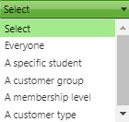
Discount Recipients
Who should receive the discount?
Specific Student - you can use this to award an individual student
Customer Group - this is most often used for students you assign to a group, like Financial Aid, or Honor Roll students.
Membership Level - "All Gold Members receive 20% off!"
Customer Type - when you have at least two different types of students, such as University students and Community students
Discounts 7min 11s
Working with discounts

Slide 21
Apply Discount to a Specific Item
What items should the discount apply to?
Class, Course, and Course Group are for targeting a specific class or classes.
Private Lesson is for discounts that apply to private lessons only. Lesson Package is for discounting lessons that are sold as a part of a package.
Time Period Fee is for discounting the registration fee for that semester/year. Time Period is for discounting classes or lessons that take place within a particular time period.
Discounts 7min 11s
Working with discounts

Slide 22
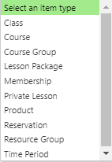
Discount for Returning Students
Are there any items that this student must have purchased in the past for this discount to be valid?
If yes...
Use this option for creating discounts for returning students. You can specify that more than one item needs to have been purchased in the past, in order for the discount to be valid.
Discounts 7min 11s
Working with discounts

Slide 23
Transaction Reports

Slide 24
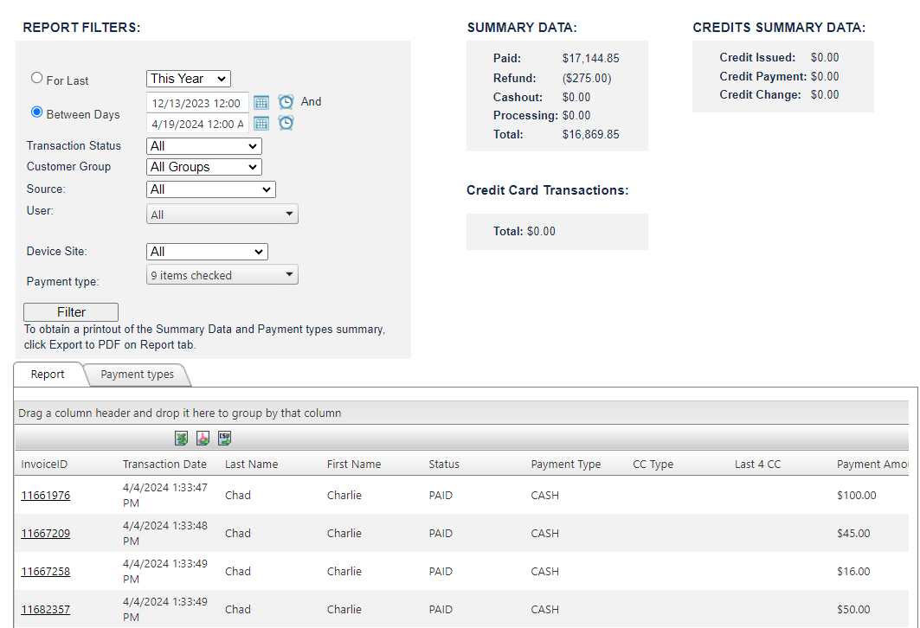
Transaction Report

Slide 25
Transaction Reports

Slide 26
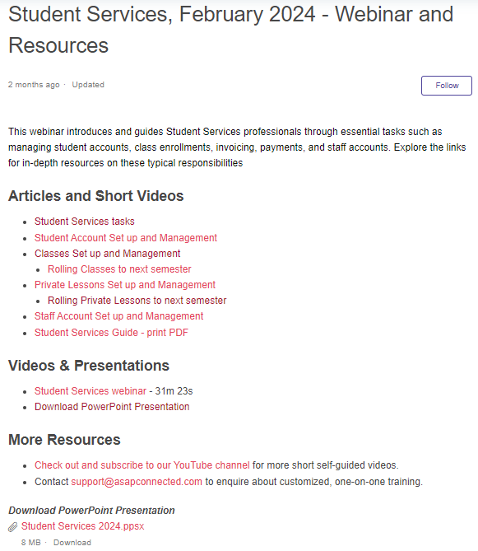
Sign up for more Webinars! https://support.asapconnected.com/hc/en-us/articles/20006314020759-Training-Webinars-Sign-Up-Schedule-Resources
Click any title below to find helpful articles, videos and past webinars
Communication Center / Feb 2023​
Discounts / Dec 2023​
Events / Mar 2023​
Fundraising / Nov 2023​
Launching a New Term, New Year / May 2020​
Memberships / Mar 2023​
Moving Classes to Online Registration / Jun 2023​
Payment Plans / Dec 2023​
Private Lessons Management / Nov 2021​
Products / Nov 2023​
Reports - Insights, Enrollment, Student / May 2023​
Rolling Classes and Lessons / Dec 2022​
Student Services / Feb 2024​
Top 10 Reports / Jan 2024​

Slide 27
Launching a New Year
https://register.gotowebinar.com/register/4405020047969999957 Thursday May 9, 2024 10:00 AM Pacific / 1:00 PM Eastern

