Slide 1
New User Refresher Training
June 13, 2024

Slide 2
Agenda
Student and Family Accounts
Enrolling Students in Classes
Taking Payments
Working with Classes
Enrolling Students in Lessons
Working with Lessons
Taking Attendance for Lessons
Taking Attendance for Classes

Slide 3
Student Accounts

Slide 4
MULTIPLE STUDENT SEARCH OPTIONS
Search by phone, email, date of birth, customer group & much more.
Intro to main pages and Class Details page

Slide 5
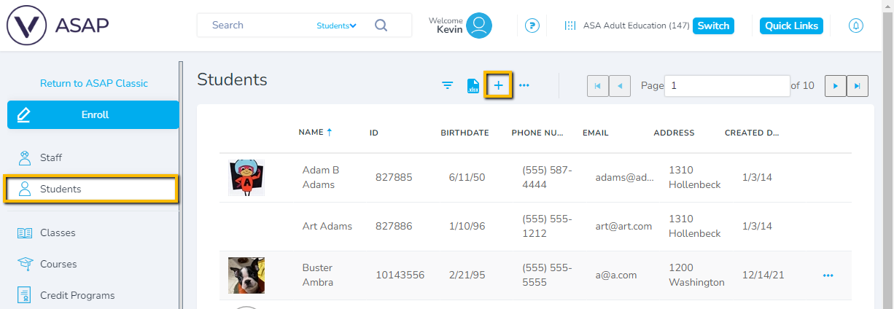
STUDENT ACCOUNTS
Student Account Creation

Slide 6
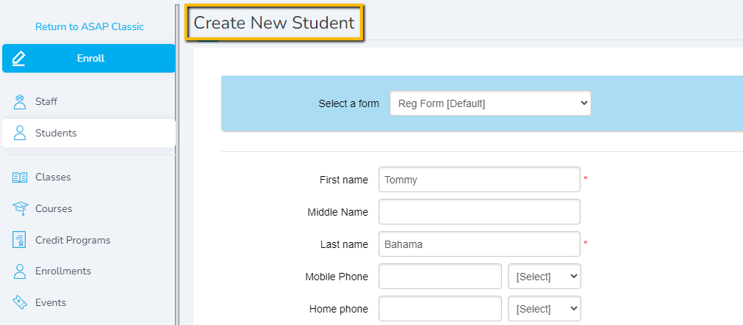
STUDENT ACCOUNTS
Student Account Creation

Slide 7
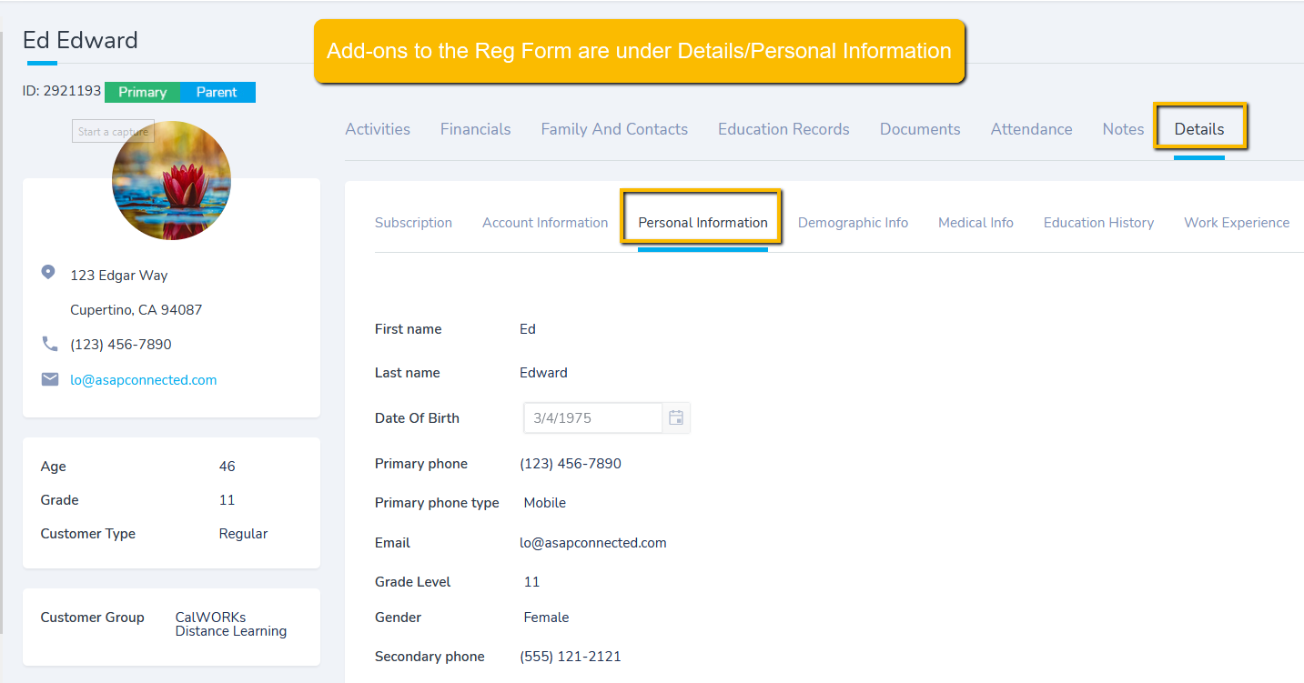
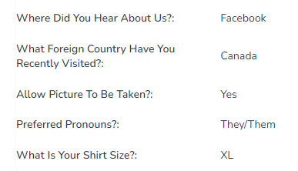
CUSTOM DATA UNDER PERSONAL INFORMATION
Student Detail Page

Slide 8
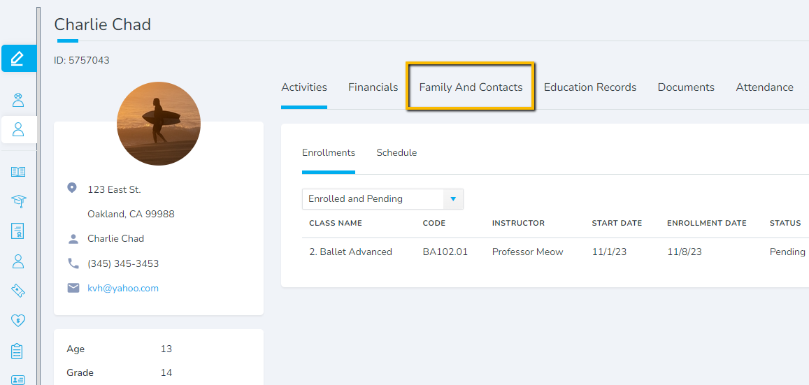
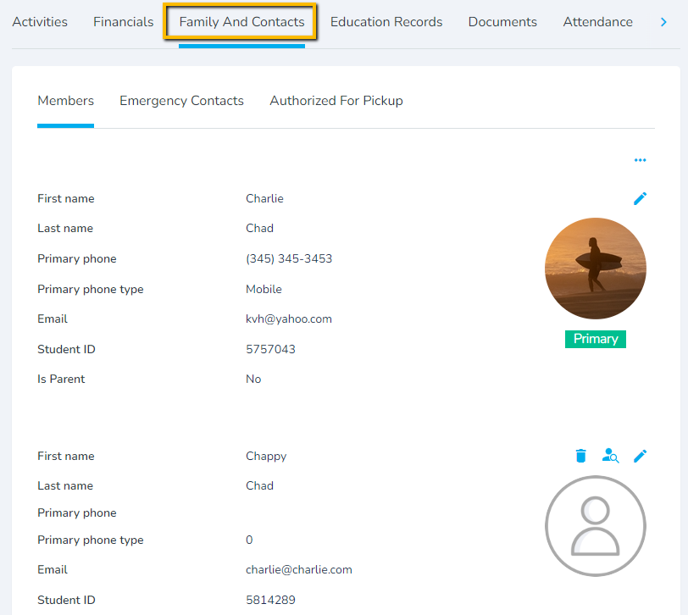
FAMILY ACCOUNTS
Student Detail Page

Slide 9
Enrolling Students in Classes

Slide 10
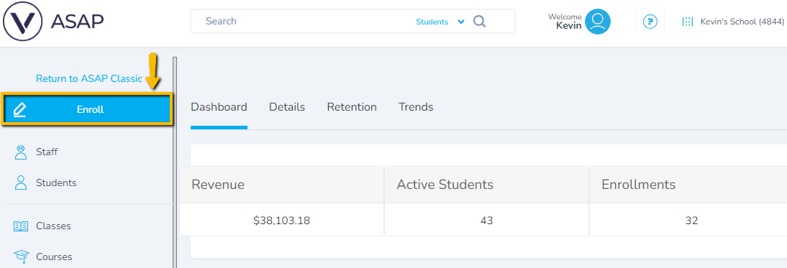
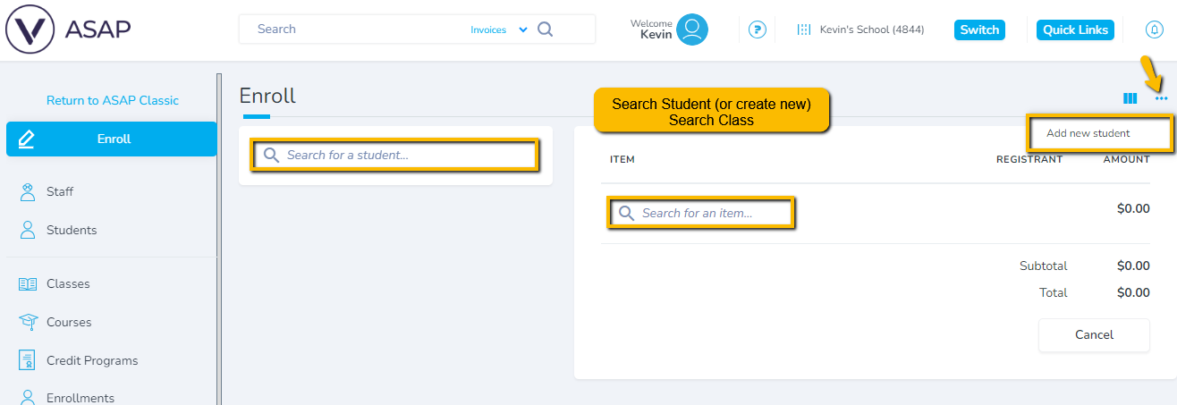
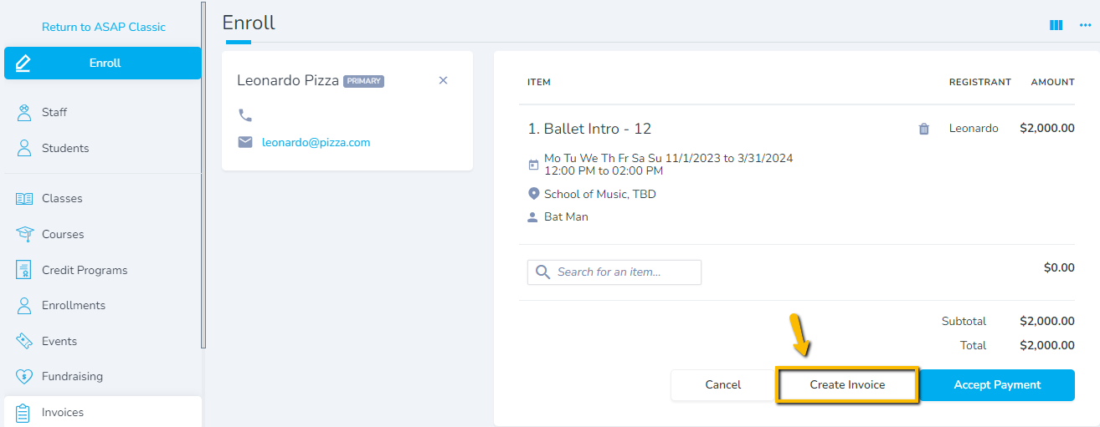
ENROLLING STUDENTS IN CLASSES
Enrolling Students

Slide 11
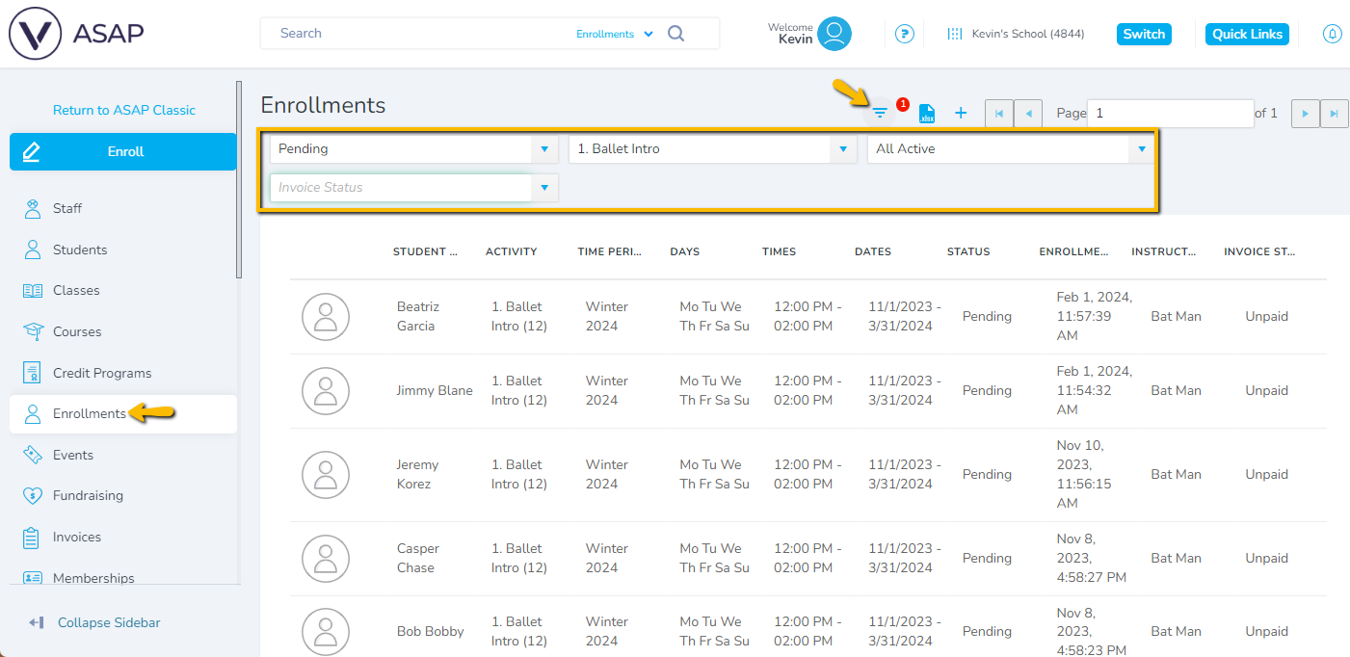
ENROLLMENTS

Slide 12
Taking Payments

Slide 13
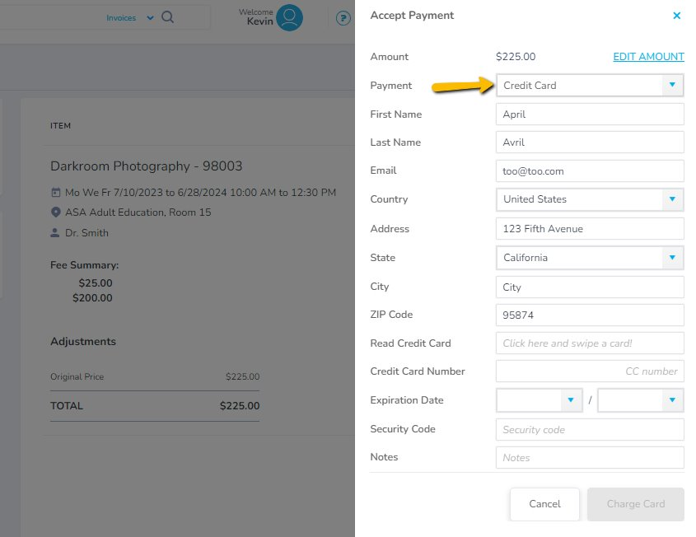
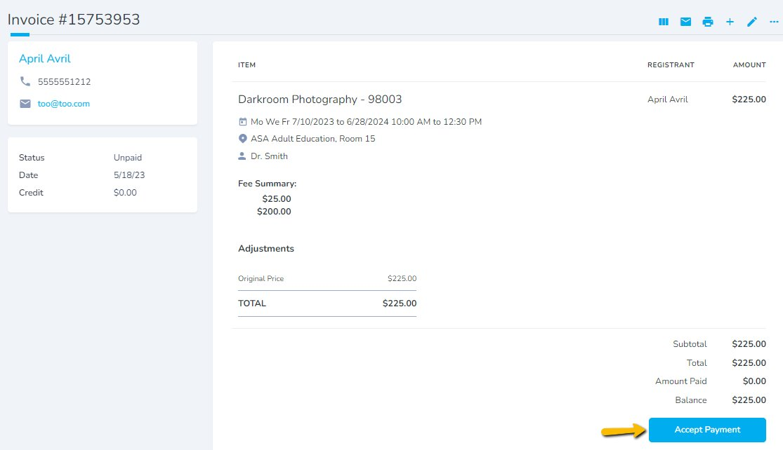
TAKING PAYMENTS
Invoice Management
Notes:
Broad intro to Invoice
Here you can:
- add a sibling/new class
- add a discount
- add a payment plan
- Process a payment
And lots more that we'll go into next webinar
While we're here, quick tip, find invoices via the 'Find Invoices' page. V useful when you're working a lot in payments

Slide 14
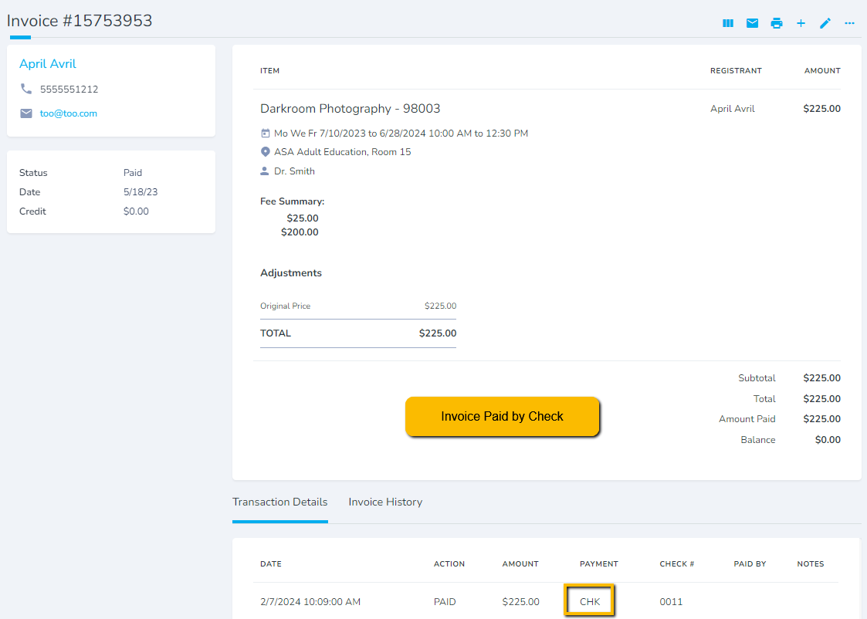
TAKING PAYMENTS
Invoice Management

Slide 15
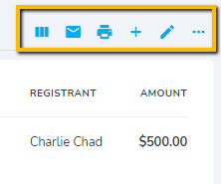
INVOICE OPTIONS
Invoice View – Full, Medium, Summary
Email invoice to customer
Print invoice
Add items
(classes, products, etc)
Manage credits, refunds, payment plans, payment reallocations, discount reallocations
Invoice Management

Slide 16
Working with Classes

Slide 17
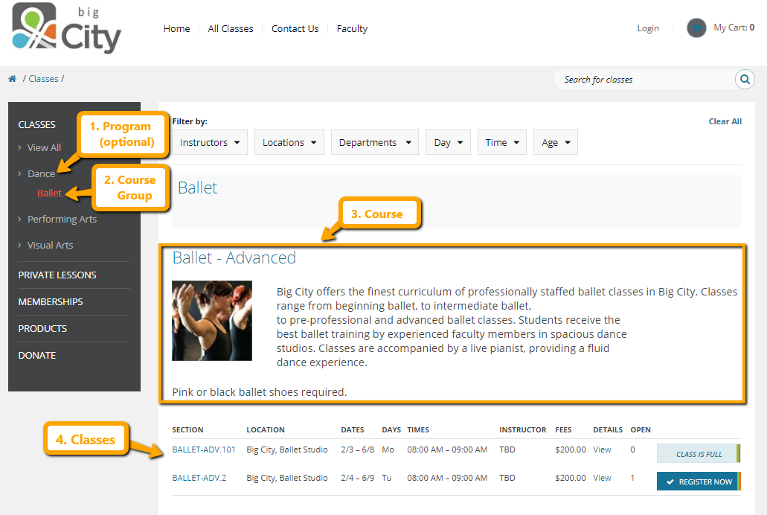
PROGRAMS TO CLASSES HIERARCHY
Notes:
Hierarchy – everyone uses these terms differently. Our way is genius – don't need to enter courses anew each term. just roll classes

Slide 18
FINDING COURSES
Notes:
There's lots of ways to find the class/course you're looking for.

Slide 19
FINDING CLASSES
Notes:
There's lots of ways to find the class/course you're looking for.

Slide 20
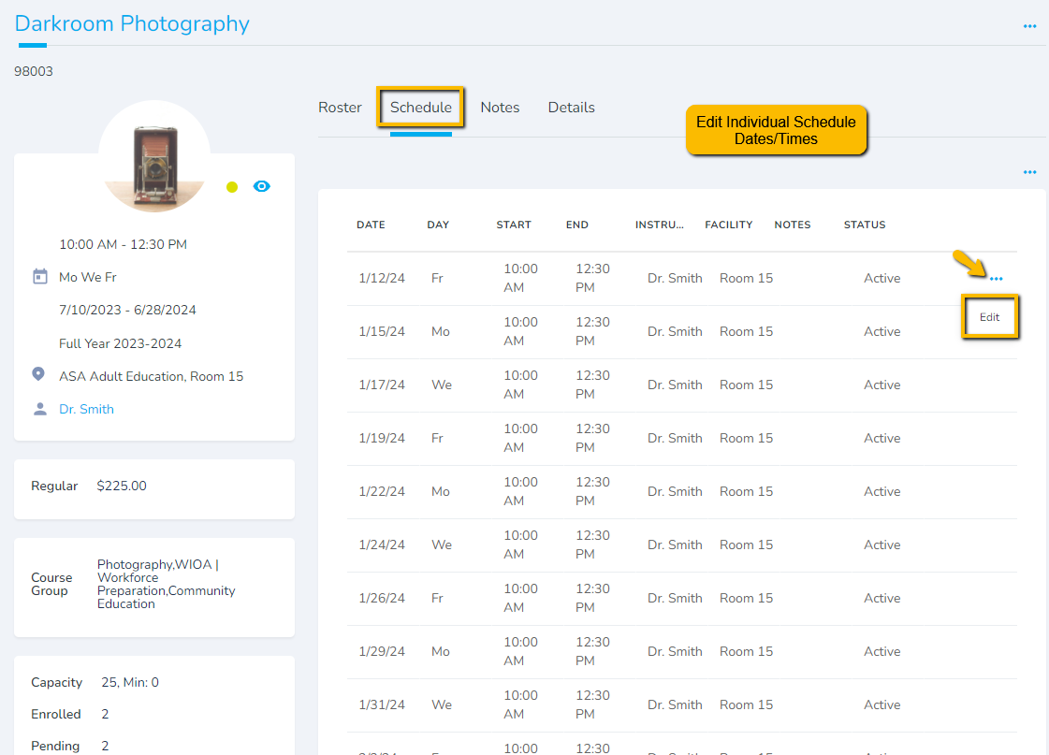
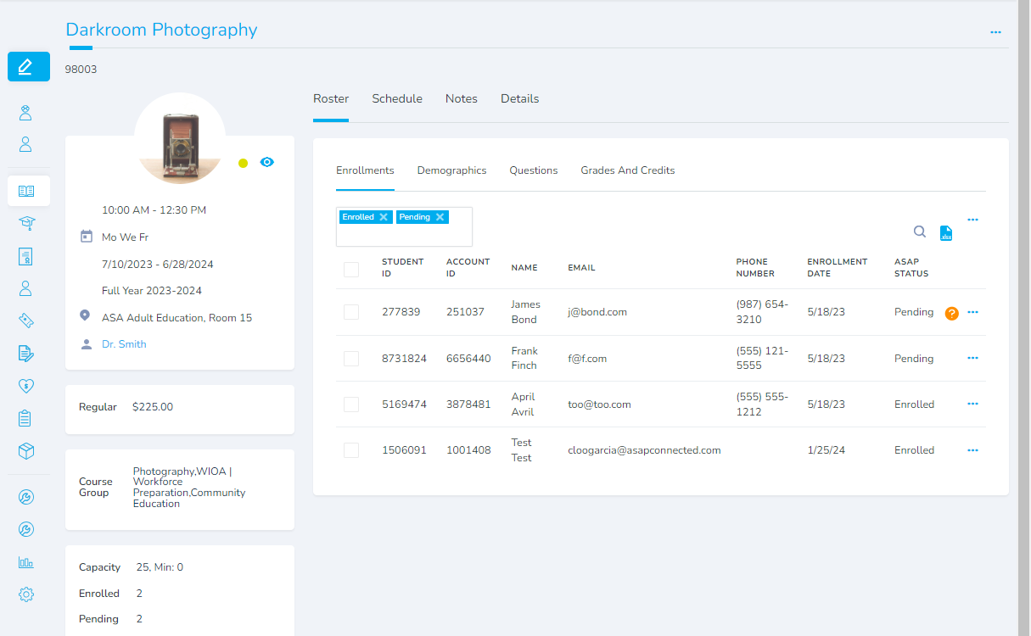
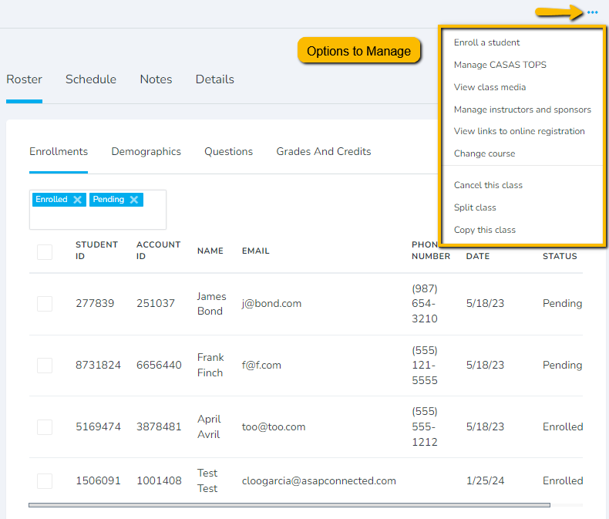
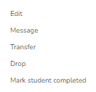
CLASS DETAIL
Class Details Page

Slide 21
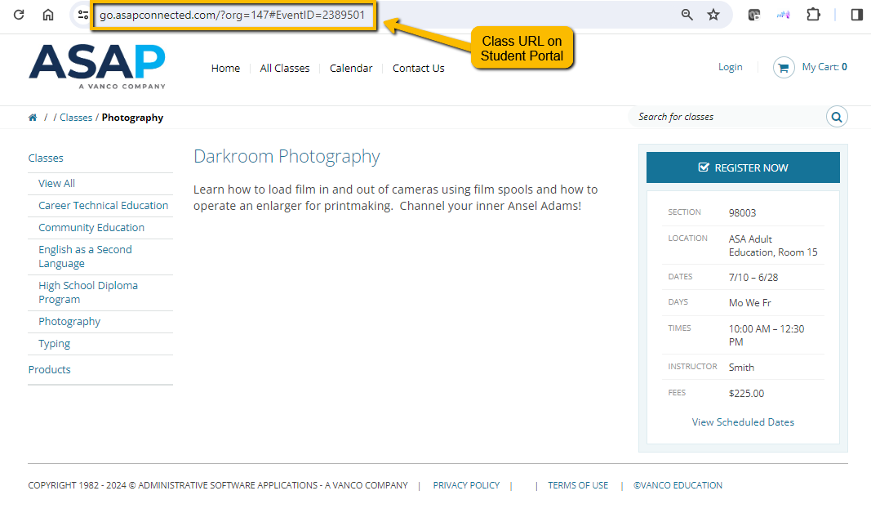
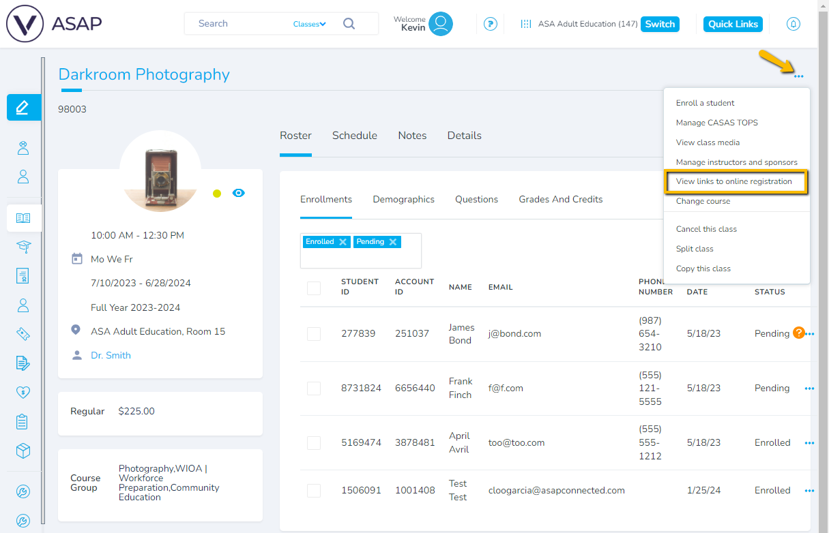
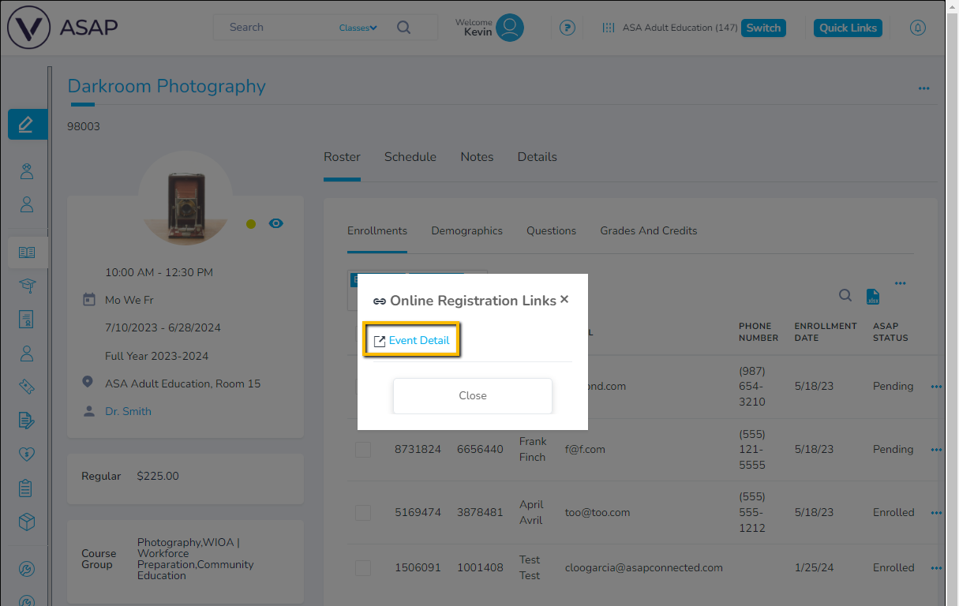
CLASS DETAIL: ONLINE REG LINK

Slide 22
Enrolling Students in Lessons

Slide 23
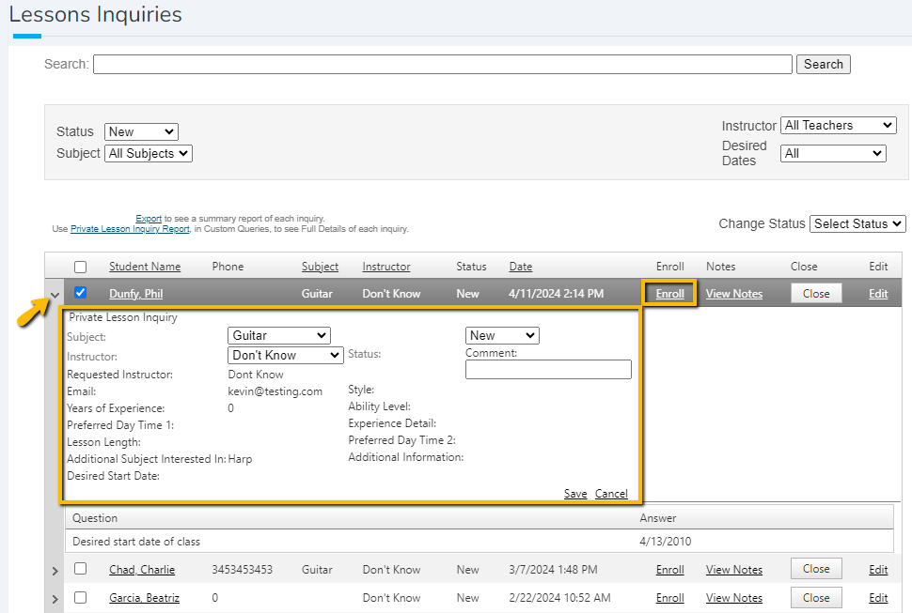
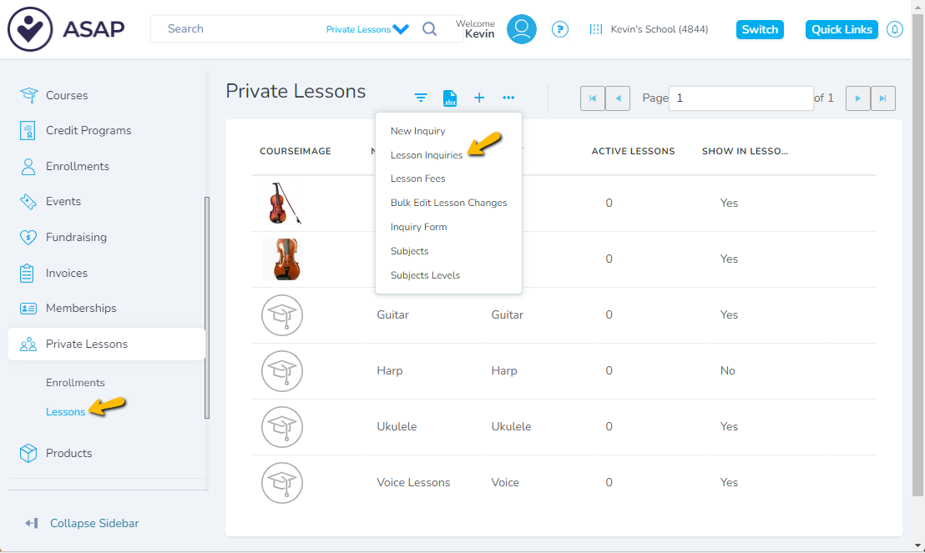
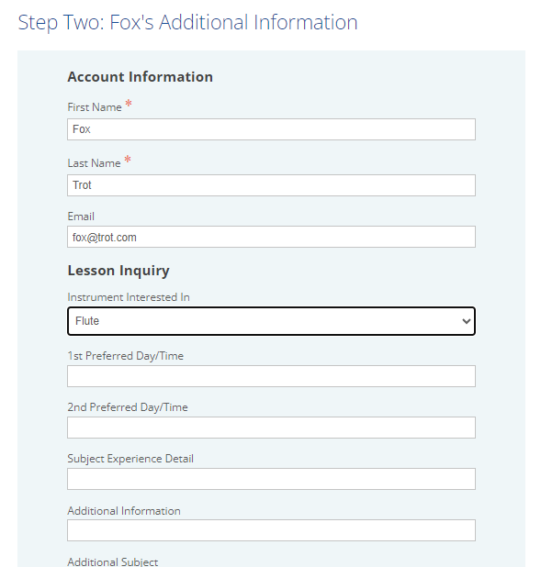
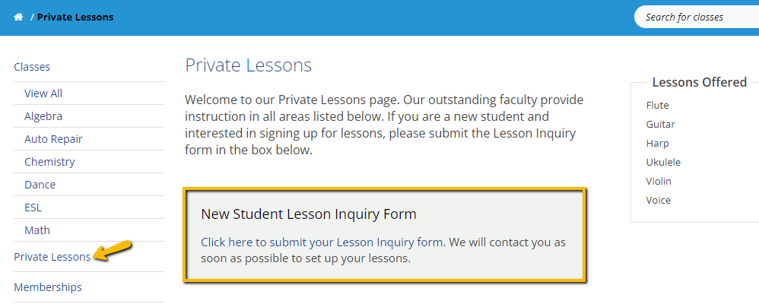
STUDENT PORTAL LESSON INQUIRY
Enroll in Private Lessons
Notes:
Enroll in PL, student must have an account already so create one if it doesn't already exist. Then go to Enroll Student.
Then complete the lesson details page

Slide 24
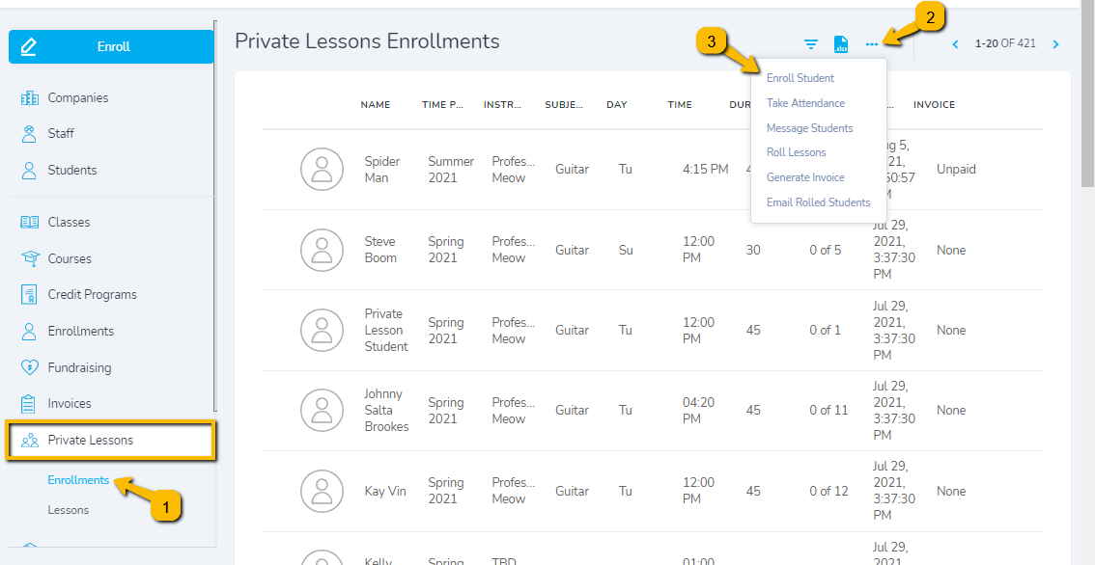
ENROLLING STUDENTS IN LESSONS
Enroll in Private Lessons
Notes:
Enroll in PL, student must have an account already so create one if it doesn't already exist. Then go to Enroll Student.
Then complete the lesson details page

Slide 25
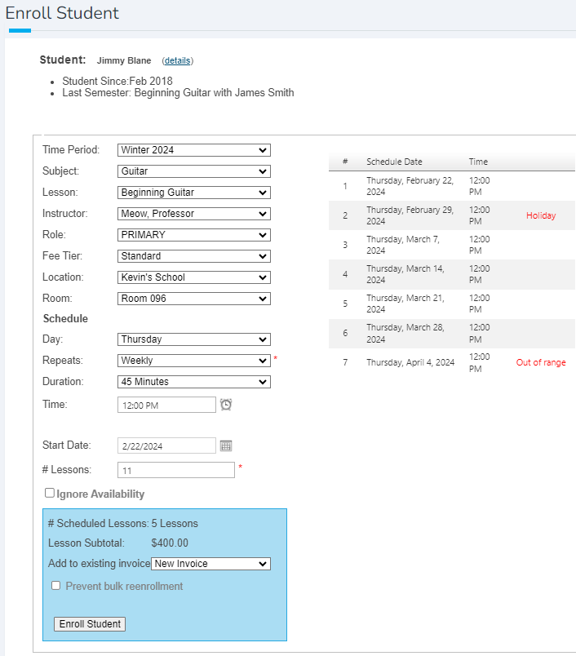
ENROLLING STUDENTS IN LESSONS
Enroll in Private Lessons
Notes:
Enroll in PL, student must have an account already so create one if it doesn't already exist. Then go to Enroll Student.
Then complete the lesson details page

Slide 26
Working with Lessons

Slide 27
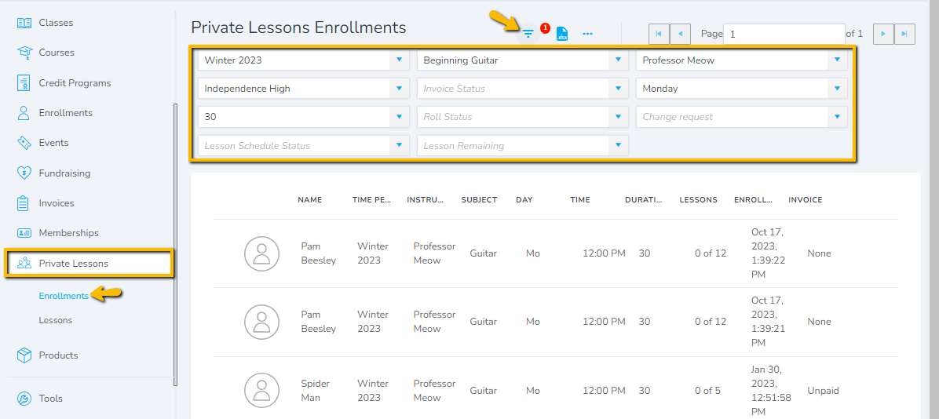
FINDING PRIVATE LESSONS
Private Lessons in A4
Notes:
ENROLLMENTS PAGE SHOWS ALL THE STUDENTS – SEARCH BY ALMOST ANYTHING RELATED TO THE LESSON LIKE TEACHER, DAY, INSTRUMENT/SUBJECT

Slide 28
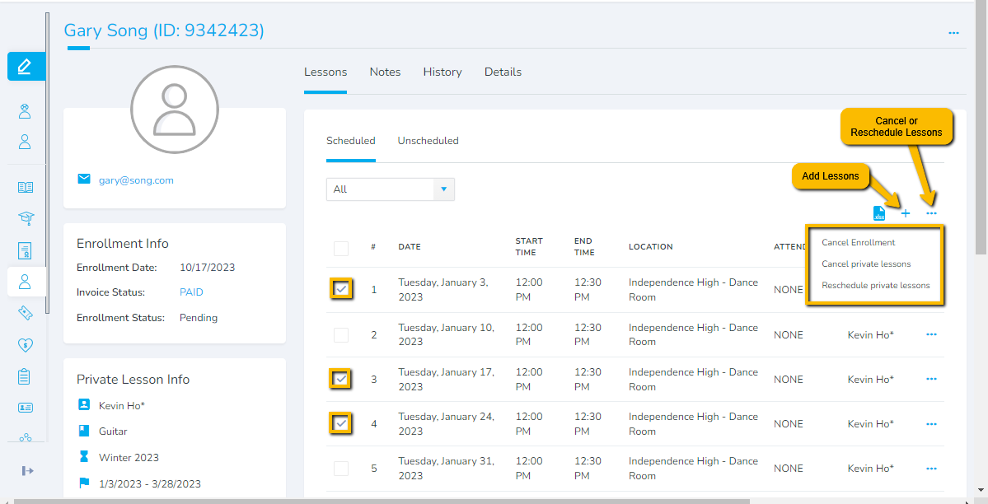
MODIFYING PRIVATE LESSONS
Private Lesson Schedule Management
Notes:
Each Private Lesson student has a lesson details page which allows you to see the schedule, and make any modifications, like rescheduling or adding lessons.

Slide 29
Taking Attendance for Lessons

Slide 30
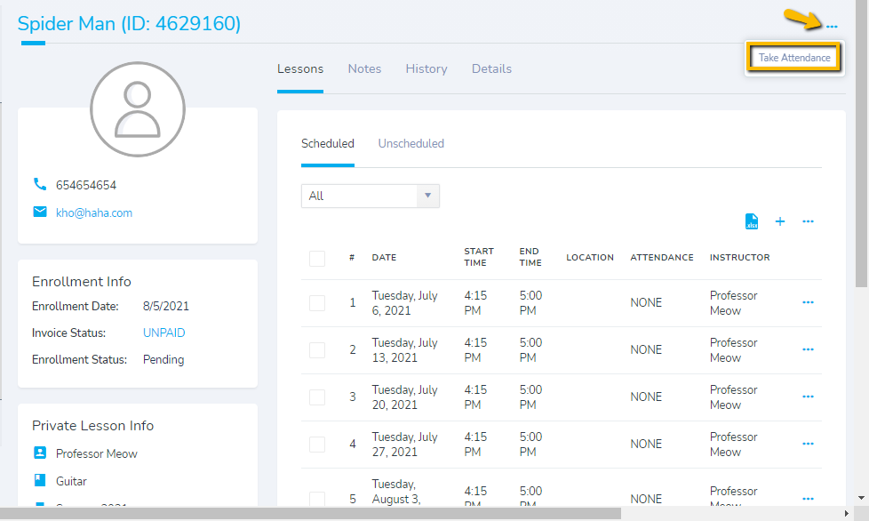
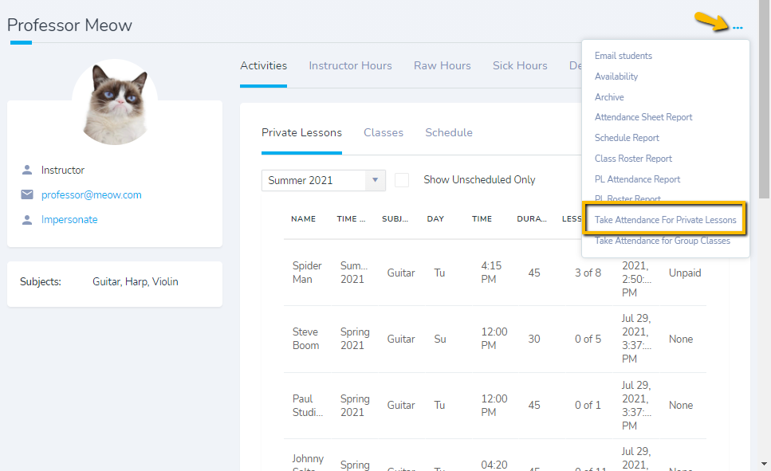
TAKING ATTENDANCE FOR LESSONS
Lesson Enrollment Page
Instructor Page
Private Lessons Attendance
Notes:
3 PLACES TO TAKE ATTENDANCE
1 – AS AN ADMIN, IN PRIVAET LESSONS > ATTENDANCE, TAKE FOR MULTIPLE TEACHERS SIMULTANEOUSLY
2 – AS A TEACHER IN MAIN APP,
3 – AS A TEACHER ON THE TEACHER'S ASSISTANT

Slide 31
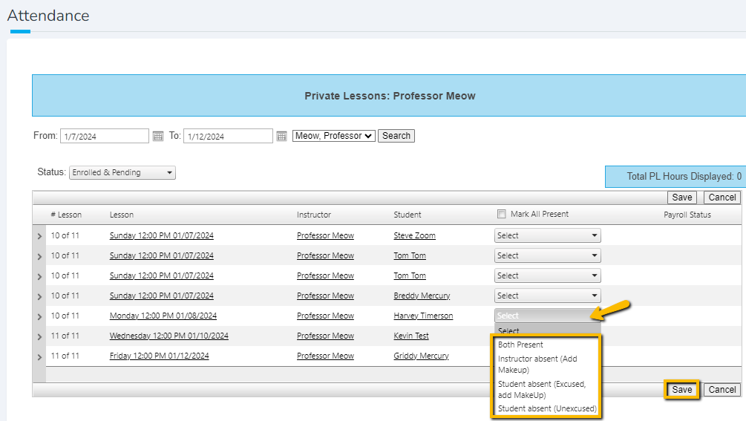
TAKING ATTENDANCE FOR LESSONS
Private Lessons Attendance

Slide 32
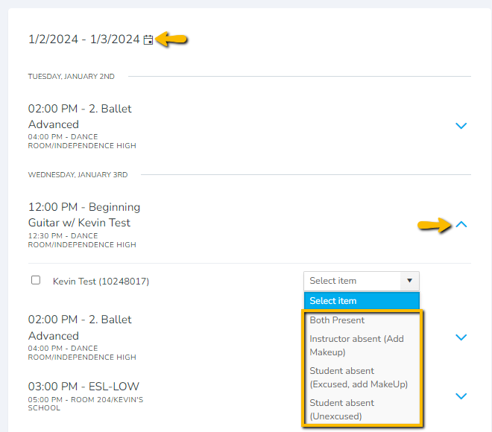
TEACHER'S ASSISTANT APP
https://admin.asapconnected.com/teacher-assistant
New Teacher's Assistant App

Slide 33
Taking Attendance for Classes

Slide 34
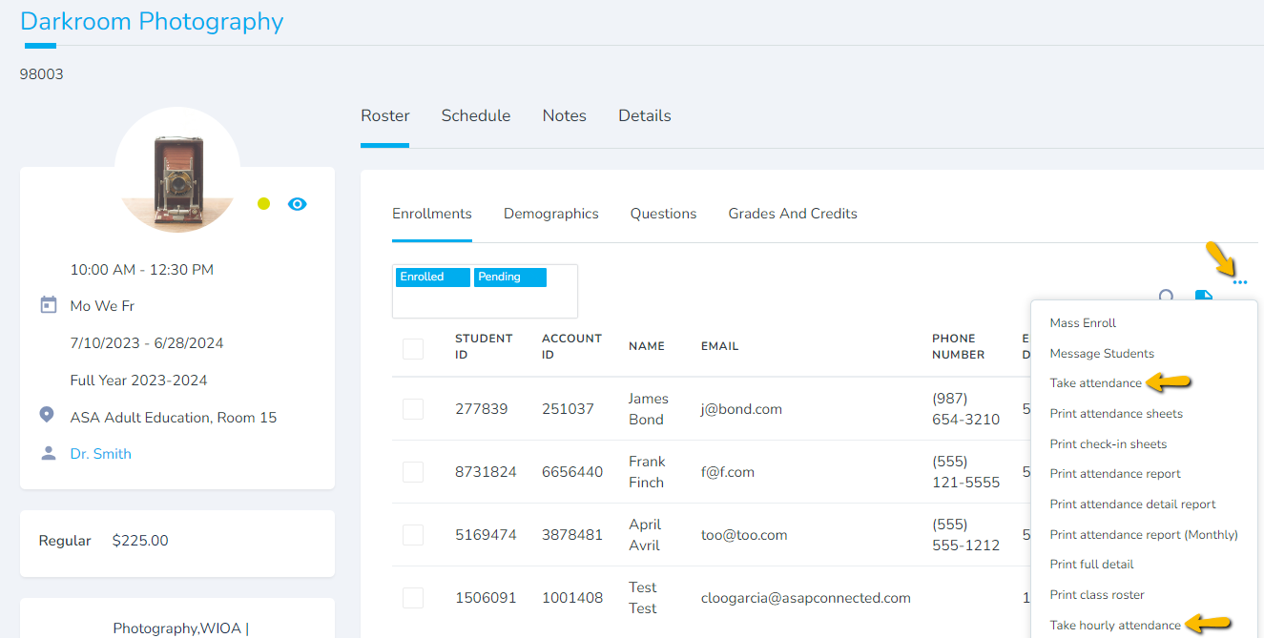
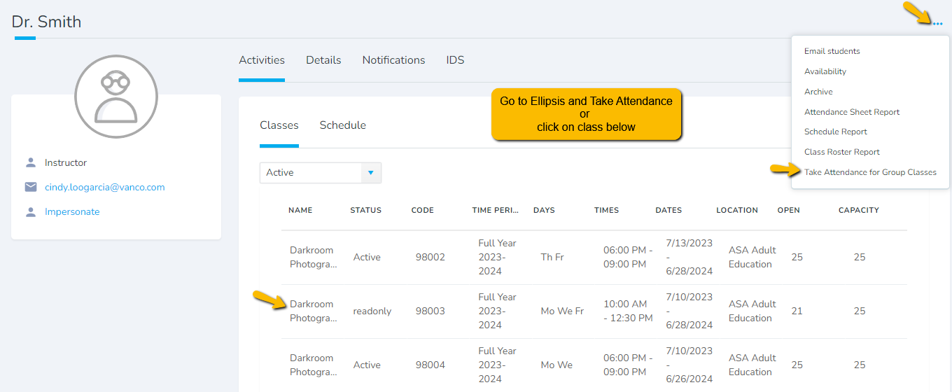
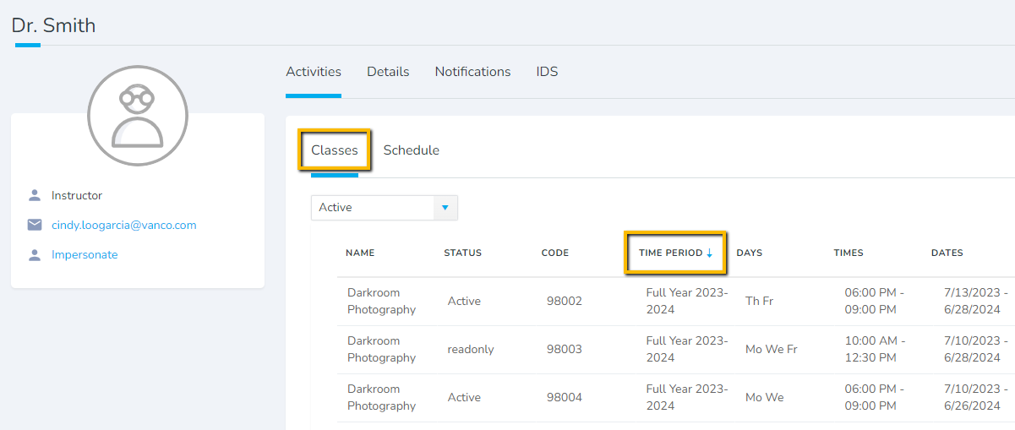
ATTENDANCE
Attendance Taking

Slide 35
TAKE ATTENDANCE
Attendance Taking

Slide 36
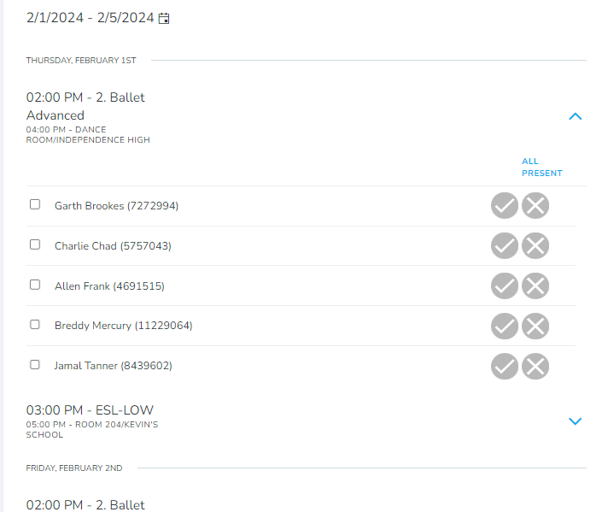
https://admin.asapconnected.com/teacher-assistant
TEACHER'S ASSISTANT APP
New Teacher's Assistant App

Slide 37
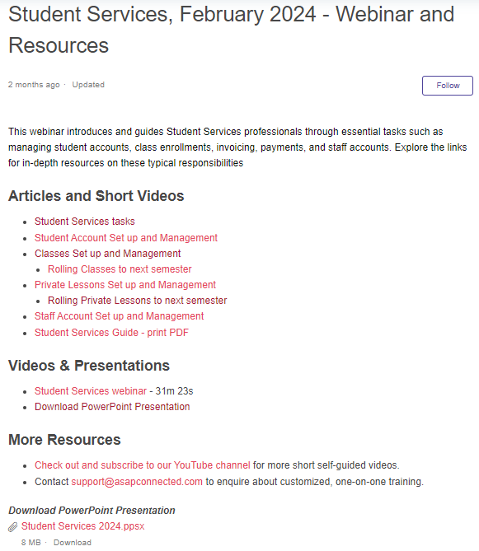
Check out ASAP's Webinar Library!
Click any title below to find helpful articles, videos and past webinars
Communication Center / Feb 2023​
Discounts / Dec 2023​
Events / Mar 2023​
Fundraising / Nov 2023​
Launching a New Term, New Year / May 2024
Memberships / Mar 2023​
Moving Classes to Online Registration / Jun 2023​
Payment Plans / Dec 2023​
Private Lessons Management / Nov 2021​
Products / Nov 2023​
Reports - Insights, Enrollment, Student / May 2023​
Rolling Classes and Lessons / Dec 2022​
Student Services / Feb 2024​
Top 10 Reports / Jan 2024​

Slide 38
Q&A

